Slide 1
The following work was completed to strengthen process control:
A mass flow meter and a sight glass were added on the iodine-solution transfer line.
Supplemental verification of the synthesizer system low-temperature limit was completed.
Synthesizer software was improved, including the reports and the displays.
Principal improvements made at the client’s request:
Operator confirmation was added for waste discharge and system transfer. The tuning-fork level switch and the PLC software were modified and verified.
Peristaltic-pump tubing is not compatible with prolonged DIC/DIPEA contact, so transfer was changed to a metering pump.
Process piping, the deprotection preparation vessel, and ancillary stainless-steel equipment were passivated and inspected, then cleaned and tested.

Slide 2
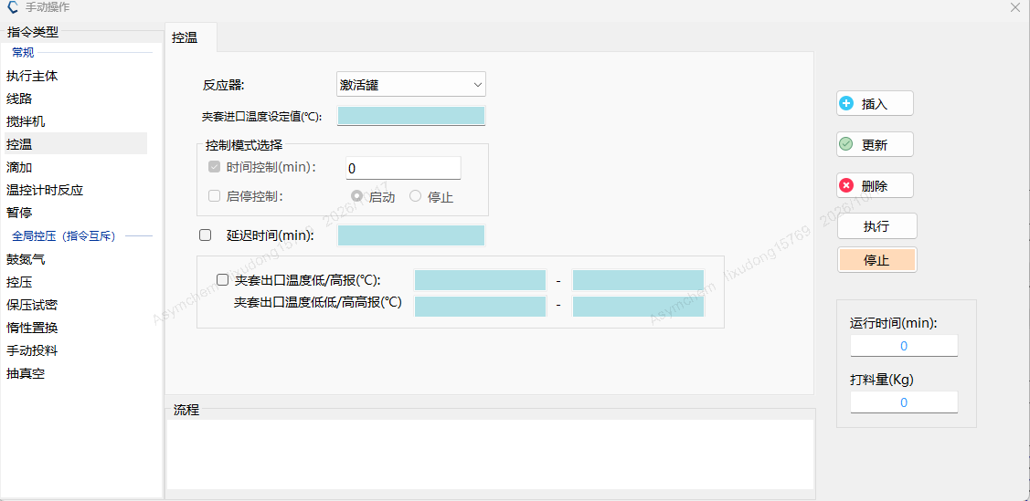
SPPS option review
2. Add high-high and low-low jacket-temperature alarms for synthesizer SY16 to the PLC.
Option assessment
Option 1 provides audible and visual alarms for the high-high and low-low limits, together with high and low pre-alarms. Personnel respond on site once an alarm is triggered, so any excursion beyond the process range is detected immediately.
Where only high and low audible and visual alarms are used, they are set as pre-alarm values. Personnel respond on site once an alarm is triggered, and any excursion beyond the process range is reconciled between the operation record (OR) and the electronic data.
The MOR already records the minimum and maximum temperature for each operation, so the risk of a missed excursion is low.
The software upgrade takes 3 days. We assess that the current software, together with the MOR record of the temperature minimum and maximum, meets production needs. We recommend keeping the current software and the MOR temperature records.
Software update
Qualification options and charging schedule
Option | 20 | 21 | 22 | 23 | 24 | 25 | 26
Option 1 | Software upgrade | Verification |  | Iodine trial |  | CMa | Charge

Slide 3
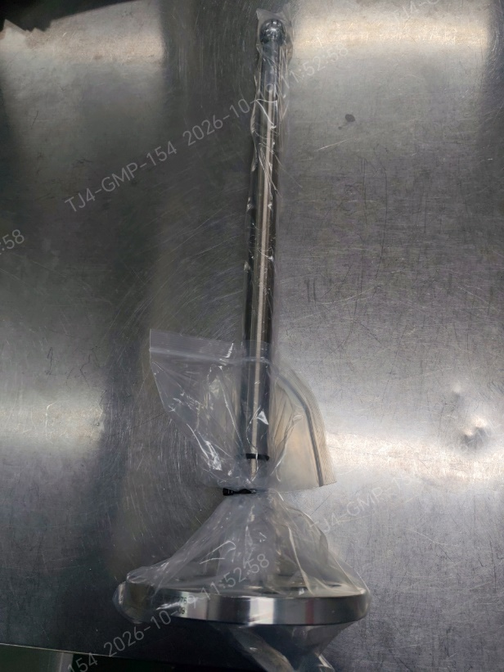
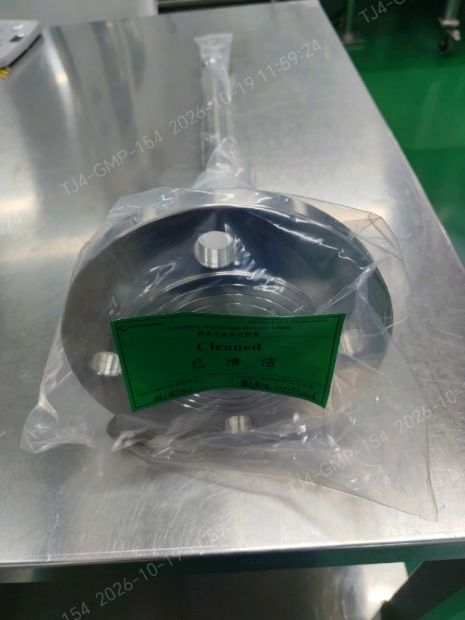
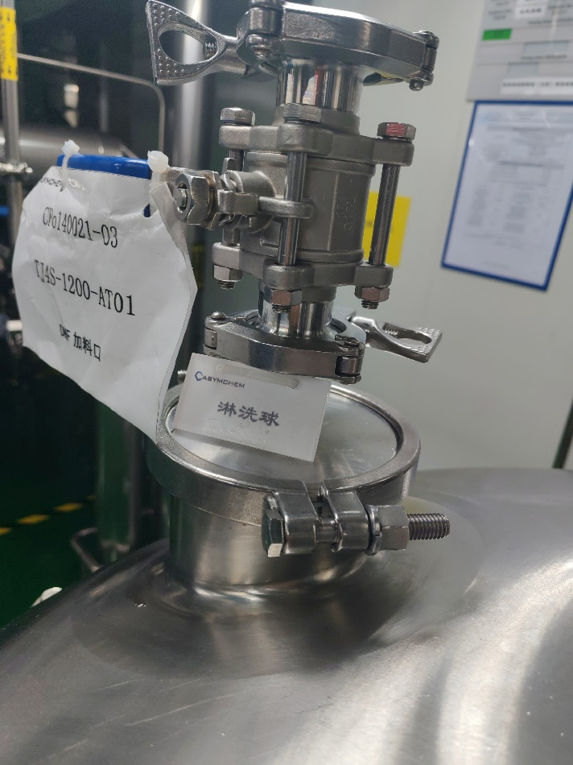
Spray-ball installation
1. Spray-ball installation, coverage test, riboflavin cleaning, and particulate check for AT09/AT01.
ASYM:
1. A stainless steel spray ball was used for the spray coverage test on mixing vessel AT09. Iodine is not compatible with prolonged stainless-steel contact, so this spray ball will be used only as a temporary accessory and will not remain in the vessel.
2. A PTFE spray ball has been purchased for mixing vessel AT09, following Lilly's recommendation and material-compatibility assessment. Given the project timeline, we recommend a trial run and completion of the supplemental spray-coverage verification and cleaning confirmation before this vessel is used for the project.
Proposed completion date: 10/20/2026
3. Mixing vessel AT01 is equipped with a spray ball and has completed spray coverage testing. The missing on-site identification tag has been corrected.
Fixing the spray ball in place would add 2 days for verification and cleaning. We recommend keeping the current rinse method.
Qualification options and charging schedule
Option | 20 | 21 | 22 | 23 | 24 | 25 | 26
Option 1 | Coverage test | Iodine trial |  | CMa | Charge
Option 2 | Iodine trial |  | CMa / Dispense | Charge
TJ4S-1213-AT09 Dedicated spray ball
TJ4S-1200-AT01

Slide 4

Step# | 1 | Batch No. | 2 | Batch start | 2026/10/22 16:00 | Batch cycle (d) |  | 12.7 d | Completed | Ongoing
Material dispensing: a portion of Oxyma is dispensed first, followed by PyBOP and the amino acid. The remaining Oxyma is then dispensed so charging can proceed quickly. From Batch 2, the order will be adjusted as appropriate. | No. | AAs | Begin | End | Unit operation time (h) | Dispensing | Begin | End | Unit operation time (h) | Dispensing | Begin | End | Unit operation time (h)
 | 1 | 2-Chlorotrityl Chloride Resin | 2026/10/22 16:00 | 2026/10/22 20:00 | 4
 | 2 | Fmoc-Gly-OH | 2026/10/24 4:00 | 2026/10/24 8:00 | 4
 | 3 | Fmoc-L- Thr(tBu)-OH | 2026/10/24 10:00 | 2026/10/24 14:00 | 4 | Oxyma | 2026/10/22 22:00 | 2026/10/23 0:00 | 2 | PyBOP | 2026/10/23 18:00 | 2026/10/23 22:00 | 4
 | 4 | Fmoc-L-Ala-OH·H₂O | 2026/10/25 0:00 | 2026/10/25 4:00 | 4 | Oxyma | 2026/10/23 2:00 | 2026/10/23 4:00 | 2
 | 5 | Fmoc-L- Cys(Trt)-OH | 2026/10/25 10:00 | 2026/10/25 14:00 | 4 | Oxyma | 2026/10/23 6:00 | 2026/10/23 8:00 | 2
 | 6 | Fmoc-L- Thr(tBu)-OH | 2026/10/24 14:00 | 2026/10/24 18:00 | 4 | Oxyma | 2026/10/23 10:00 | 2026/10/23 12:00 | 2
 | 7 | Fmoc-L-Ala-OH·H₂O | 2026/10/25 4:00 | 2026/10/25 8:00 | 4 | Oxyma | 2026/10/23 14:00 | 2026/10/23 16:00 | 2
 | 8 | Fmoc-L- Thr(tBu)-OH | 2026/10/24 18:00 | 2026/10/24 22:00 | 4 | Oxyma | 2026/10/26 8:00 | 2026/10/26 10:00 | 2
 | 9 | Fmoc-L-Asn(Trt)-OH | 2026/10/25 20:00 | 2026/10/26 0:00 | 4 | Oxyma | 2026/10/26 12:00 | 2026/10/26 14:00 | 2
 | 10 | Fmoc-L- Cys(Trt)-OH | 2026/10/25 14:00 | 2026/10/25 18:00 | 4 | Oxyma | 2026/10/26 16:00 | 2026/10/26 18:00 | 2
 | 11 | Boc-L-Glu-OtBu | 2026/10/26 2:00 | 2026/10/26 6:00 | 4 | Oxyma | 2026/10/26 20:00 | 2026/10/26 22:00 | 2 | PyBOP | 2026/10/23 22:00 | 2026/10/24 2:00 | 4
 | 12 | Iodine | 2026/10/27 0:00 | 2026/10/27 4:00 | 4
1. Fmoc-Gly-OH coupling cycle | Gly
 | Unit operation |  | Pre-treatment |  | Charge resin |  | Swelling & wash |  | Charge amino acid |  | Activation |  | Coupling |  | DMF wash |  | Capping |  | DMF wash
 | Time |  | Begin | End | Begin | End | Begin | End | Begin | End | Begin | End | Begin | End | Begin | End | Begin | End | Begin | End
 | Synthesizer |  | 2026/10/24 8:00 | 2026/10/24 14:00 | 2026/10/24 14:00 | 2026/10/24 16:00 | 2026/10/24 16:00 | 2026/10/24 19:00 |  |  |  |  | 2026/10/24 19:30 | 2026/10/24 23:30 | 2026/10/24 23:30 | 2026/10/25 2:00 | 2026/10/25 2:00 | 2026/10/25 5:00 | 2026/10/25 5:00 | 2026/10/25 7:30
 | Activation reactor |  |  |  |  |  |  |  | 2026/10/24 16:00 | 2026/10/24 18:00 | 2026/10/24 18:00 | 2026/10/24 19:30
 | Unit operation time (h) |  | 6 |  | 2 |  | 3 |  | 2 |  | 1.5 |  | 4 |  | 2.5 |  | 3 |  | 2.5
2. Fmoc-L-Thr(tBu)-OH coupling cycle | Thr
 | Unit operation |  | Fmoc removal |  | IPAC wash |  | DMF wash |  | Charge AA & Oxyma |  | Activation |  | Coupling |  | DMF wash
 | Time |  | Begin | End | Begin | End | Begin | End | Begin | End | Begin | End | Begin | End | Begin | End
 | Synthesizer |  | 2026/10/25 7:30 | 2026/10/25 11:00 | 2026/10/25 11:00 | 2026/10/25 14:30 | 2026/10/25 14:30 | 2026/10/25 16:30 |  |  |  |  | 2026/10/25 18:30 | 2026/10/25 22:30 | 2026/10/25 22:30 | 2026/10/26 1:00
 | Activation reactor |  |  |  |  |  |  |  | 2026/10/25 11:00 | 2026/10/25 14:00 | 2026/10/25 16:30 | 2026/10/25 18:30
 | Unit operation time (h) |  | 3.5 |  | 3.5 |  | 2 |  | 3 |  | 2 |  | 4 |  | 2.5
3. Fmoc-L-Ala-OH·H2O coupling cycle | Ala
 | Unit operation |  | Fmoc removal |  | IPAC wash |  | DMF wash |  | Charge AA & Oxyma |  | Activation |  | Coupling |  | DMF wash
 | Time |  | Begin | End | Begin | End | Begin | End | Begin | End | Begin | End | Begin | End | Begin | End
 | Synthesizer |  | 2026/10/26 1:00 | 2026/10/26 4:30 | 2026/10/26 4:30 | 2026/10/26 8:00 | 2026/10/26 8:00 | 2026/10/26 10:00 |  |  |  |  | 2026/10/26 11:30 | 2026/10/26 15:30 | 2026/10/26 15:30 | 2026/10/26 18:00
 | Activation reactor |  |  |  |  |  |  |  | 2026/10/26 4:30 | 2026/10/26 6:30 | 2026/10/26 10:00 | 2026/10/26 11:30
 | Unit operation time (h) |  | 3.5 |  | 3.5 |  | 2 |  | 2 |  | 1.5 |  | 4 |  | 2.5

Slide 5
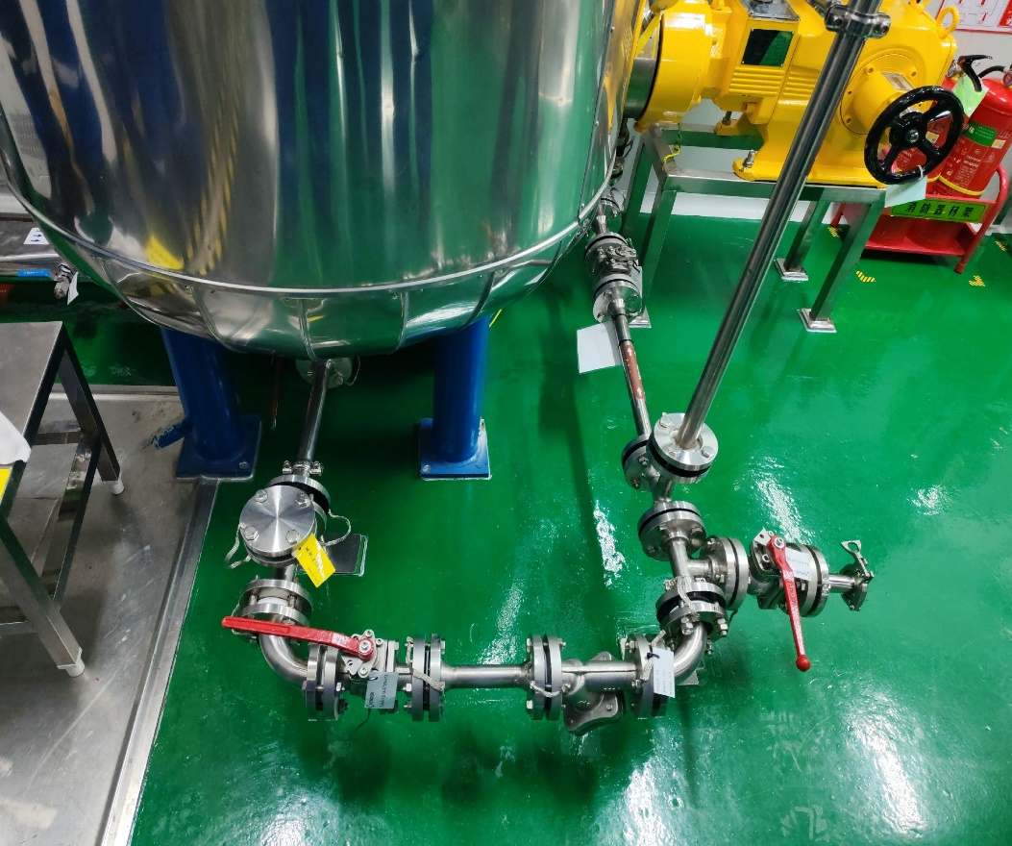
Piping correction
3. Qualification of the iodine-solution nitrogen transfer time before the solvent run.
ASYM: Nitrogen transfer of the iodine solution to the synthesizer will be performed during the solvent run.
Proposed completion date: 10/22/2026
4. Post-oxidation DMF cooling-time qualification in the activation tank, during the solvent run.
ASYM: The post-oxidation DMF cooling-time test in the activation tank will be performed during the solvent run.
Proposed completion date: 10/22/2026
5. Removal of dead legs from the unused branches of the iodine-solution transfer line.
ASYM: Completed. The redundant valve was removed, and a PTFE blind flange was installed and identified.

Slide 6
6. Pre-production acceptance of equipment-train rinse and swab cleanliness, or an equivalent criterion stated in the contamination control strategy.
ASYM:
1. Cleaning of the equipment train after passivation is complete, and TOC testing is complete.
2. Elemental iodine is used during the solvent run. After the run, the equipment train will be cleaned, and test strips will be used to confirm removal of iodine residue.

